Slide 1


Statistical Process Control: A Deep learning Implementation
Robert van Aswegen
30/11/2024

Slide 2


INTRODUCTION & OVERVIEW
Data
MC Simulation
Cleaning (IC & OOC)
1D CNN
Sequential modelling
2D-CNN
Complex pattern
Introduction
Problem
Conclusion
Future Research
SPC

Slide 3
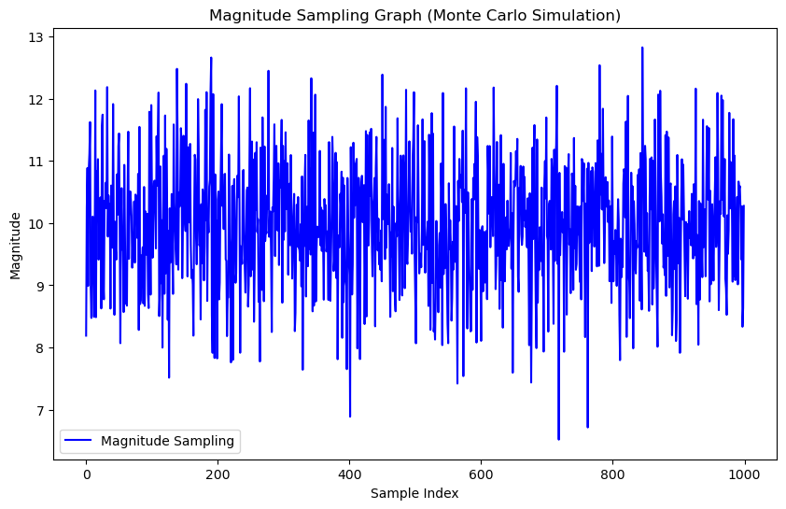
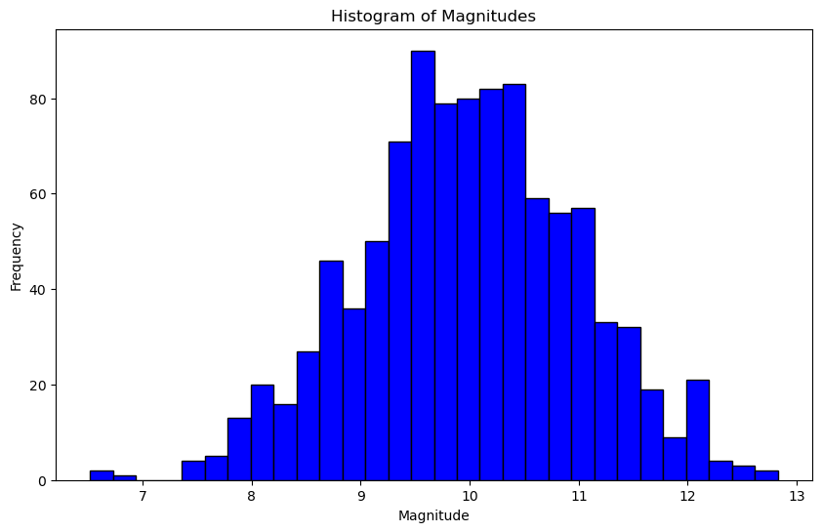
Monte Carlo Simulation
MC Simulation to create Multivariate SPC Data
Multivariate Random Normal Distrubution
1000 Samples created -> 500/500 In / out Control

Slide 4
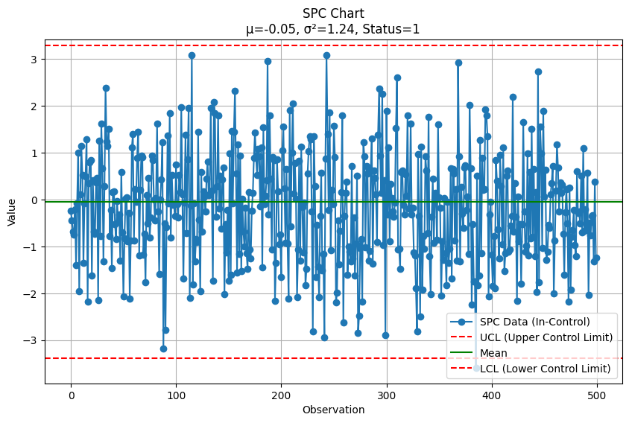
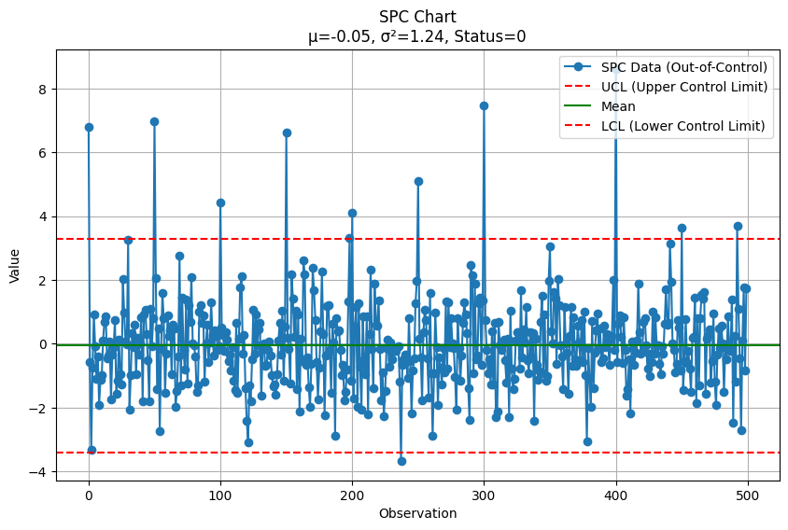
Data preparation and cleaning
Cleaning the data
In Control SPC data – Remove all out of band data points
Out of Control SPC data – Keeping all datapoint irrespective if they are outside the Lower Control Limit or the Upper Control Limit

Slide 5
2D-CNN
1D-CNN
Used to for sequnetial data structures.
Very important in SPC
Complex relationship modelling
Hoping to use for future
MODEL | Accuracy | Precision | Recall | F1
1D-CNN | 98,48% | 98,53% | 98,48% | 98,48%
2D-CNN | 98,86% | 98,88% | 98,86% | 98,86%
2D-CNN outperformed 1D-CNN.
Was tested on different Train/Test splits, 70/30 vs 40/60.
Thus meaning 2D-CNN better at performing these task, but 1D-CNN needed for the trend and sequential modeling

Slide 6
CONCLUSION
Models
1D-CNN: Specializes in sequential patterns like our patterns and shifts
2D-CNN: Effective for complex relationships
Drawback
Both models had some challenges with generalization, the two models were also tested on different test/train splits.
Need to improve upon SPC principles
Future research:
Real world data testing (Medical & Financial)
Live testing
Hybrid models like a Graph Neural Network & BI-LSTM NN

Slide 7
THANK YOU
+
Q&A
Robert van Aswegen
u18014519@tuks.co.za

